Slide 1


M.Tech/MCA Program
Advanced Industry Integrated Programs
Jointly offered by University and LTIMindTree
Review II
Real-Time DevOps Incident Triage & Auto-Remediation Agent
Noel Jacob Biju
MTech AI&ML with LTiMindtree collaboration
T9988
VIT Chennai
Knowledge partner | Implementation partner

Slide 2
Real-Time DevOps Incident Triage & Auto-Remediation Agent
Introduction….
The Agentic SRE Copilot is an AI-powered incident management and auto-remediation platform designed to automate the complete lifecycle of incident detection, analysis, diagnosis, and recovery in cloud-native environments. The system leverages Multi-Agent AI, Retrieval-Augmented Generation (RAG), MiniLM embeddings, ChromaDB, and Kubernetes to intelligently perform incident triage, log and metrics analysis, root cause identification, and context-aware runbook retrieval. Based on the identified root cause, it generates remediation recommendations and executes automated recovery actions such as deployment restarts and scaling through Kubernetes. By minimizing manual intervention and enabling self-healing capabilities, the Agentic SRE Copilot reduces Mean Time to Resolution (MTTR), improves service reliability, and enhances the operational efficiency of modern cloud-native applications.

Slide 3
Real-Time DevOps Incident Triage & Auto-Remediation Agent
Objective….
The primary objective of the Agentic SRE Copilot is to automate incident management and remediation in cloud-native environments using Artificial Intelligence, Retrieval-Augmented Generation (RAG), and Kubernetes. The system aims to perform intelligent incident triage, log and metrics analysis, root cause identification, context-aware runbook retrieval, and automated recovery actions to reduce Mean Time to Resolution (MTTR), minimize manual intervention, improve service reliability, and enable self-healing infrastructure for modern applications.

Slide 4
Real-Time DevOps Incident Triage & Auto-Remediation Agent
Module name
Module Name | Function
Incident Ingestion Module | Collects incident data, logs, metrics, and events from monitoring systems.
Incident Triage Module | Classifies incidents based on severity and priority.
Log Analysis Module | Analyzes logs to identify errors, exceptions, and anomalies.
Metrics Analysis Module | Monitors performance metrics such as latency and response time.
Root Cause Analysis (RCA) Module | Determines the underlying cause of incidents and failures.
Runbook Retrieval (RAG) Module | Retrieves relevant troubleshooting guides and operational runbooks.
Remediation Planning Module | Generates recovery actions based on RCA results and retrieved runbooks.
LLM Intelligence Module | Uses Groq-powered LLMs for reasoning and decision-making.
Kubernetes Auto-Remediation Module | Executes actions such as deployment restart and scaling.
Workflow Orchestration Module | Coordinates communication between all modules and manages the workflow.

Slide 5
Real-Time DevOps Incident Triage & Auto-Remediation Agent
Methodology/Modeling Plan….
The Agentic SRE Copilot follows a Multi-Agent AI and RAG-based approach to automate incident management in cloud-native environments. The process begins with the Incident Ingestion Module, which collects incident details, logs, and performance metrics. The Incident Triage Module prioritizes incidents based on severity, while the Log Analysis and Metrics Analysis Modules identify anomalies and performance issues. The Root Cause Analysis (RCA) Module then determines the underlying cause of the incident by correlating the collected information.

Slide 6
Real-Time DevOps Incident Triage & Auto-Remediation Agent
Methodology/Modeling Plan….(Continuation)
The identified root cause is converted into embeddings using MiniLM and searched against ChromaDB to retrieve relevant runbooks through the RAG-Based Retrieval Module. Based on the retrieved knowledge, the Remediation Planning and LLM Intelligence Modules generate recovery recommendations. Finally, the Kubernetes Auto-Remediation Module executes actions such as deployment restart, pod recovery, or scaling to restore service availability. The entire workflow is coordinated by the Workflow Orchestration Module, enabling intelligent and automated incident resolution.

Slide 7
Real-Time DevOps Incident Triage & Auto-Remediation Agent
Data preprocessing & EDA….
Data preprocessing is a crucial step in the Agentic SRE Copilot as it ensures that incident data is accurate, consistent, and suitable for analysis. The system collects incident reports, application logs, system logs, performance metrics, and runbooks from various sources. The collected data is cleaned by removing duplicate records, handling missing or inconsistent values, standardizing formats, and masking sensitive information such as credentials or confidential data. After preprocessing, the textual information is transformed into semantic vector representations using the MiniLM embedding model. These embeddings are then stored in ChromaDB, enabling efficient similarity search and context-aware retrieval of troubleshooting runbooks through the RAG framework.

Slide 8
Real-Time DevOps Incident Triage & Auto-Remediation Agent
Data preprocessing & EDA….(Continuation)
Exploratory Data Analysis (EDA) is performed to gain insights into incident behavior and system performance. The analysis focuses on identifying recurring failure patterns, common root causes, error frequencies, latency trends, response times, and resource utilization metrics. By examining these patterns, the system can better understand relationships between incidents and operational metrics, improving the accuracy of root cause analysis and remediation planning. The insights obtained from EDA help optimize incident classification, enhance runbook retrieval, and support faster automated recovery, ultimately reducing Mean Time to Resolution (MTTR) and improving overall service reliability.

Slide 9
Real-Time DevOps Incident Triage & Auto-Remediation Agent
Data Privacy and Security
Data privacy is an important consideration in the Agentic SRE Copilot, as incident logs may contain sensitive information such as credentials, API keys, IP addresses, and system configurations. To protect this data, sensitive information is sanitized or masked before analysis, and incident data can be processed locally using MiniLM and ChromaDB. The system uses Role-Based Access Control (RBAC) to restrict access to remediation actions and operational data. Additionally, external website links are not automatically trusted and must be validated before use to avoid security risks. By relying on trusted internal runbooks and secure processing mechanisms, the platform ensures confidentiality, integrity, and secure incident management.

Slide 10
Real-Time DevOps Incident Triage & Auto-Remediation Agent
Approach/Algorithms/Tools
The Agentic SRE Copilot adopts a Multi-Agent AI and Retrieval-Augmented Generation (RAG) based approach to automate incident management and recovery. The system begins by collecting incident data, logs, and performance metrics through FastAPI APIs. The Incident Triage Agent prioritizes incidents based on severity, while the Log Analysis and Metrics Analysis Modules identify anomalies, failures, and performance bottlenecks. The Root Cause Analysis (RCA) Module correlates this information to determine the most probable cause of the incident.

Slide 11
Real-Time DevOps Incident Triage & Auto-Remediation Agent
Approach/Algorithms/Tools….(Continuation)
To provide intelligent troubleshooting support, the identified root cause is converted into semantic embeddings using the MiniLM Embedding Model. These embeddings are stored and searched within ChromaDB, enabling the RAG Module to retrieve the most relevant runbooks and troubleshooting guides. The Groq-powered LLM enhances decision-making by generating context-aware remediation recommendations. Finally, the Kubernetes Auto-Remediation Module executes recovery actions such as deployment restarts, pod recovery, and workload scaling, enabling self-healing infrastructure and reducing Mean Time to Resolution (MTTR).

Slide 12
Real-Time DevOps Incident Triage & Auto-Remediation Agent
Approach/Algorithms/Tools….(Continuation)
Category | Algorithm / Tool | Purpose
AI Reasoning | Groq LLM | Intelligent analysis and remediation planning
Embedding Model | MiniLM | Generates semantic embeddings for incidents and runbooks
Retrieval Method | RAG | Retrieves context-aware troubleshooting information
Vector Database | ChromaDB | Stores and searches embeddings efficiently
Backend Framework | FastAPI | API development and workflow execution
Container Orchestration | Kubernetes | Automated remediation and self-healing
Workflow Management | Multi-Agent Architecture | Coordinates incident analysis and resolution
Algorithms and Tools Used

Slide 13
Real-Time DevOps Incident Triage & Auto-Remediation Agent
Project plan/milestones progress
Milestone | Description | Status
Requirement Analysis & System Design | Defined project objectives and designed the overall system architecture. | ✅ Completed
Data Preparation & RAG Development | Prepared runbooks and implemented MiniLM, ChromaDB, and RAG-based retrieval. | ✅ Completed
Incident Analysis & AI Integration | Developed triage, log analysis, metrics analysis, RCA, and LLM-based reasoning. | ✅ Completed
Kubernetes Auto-Remediation & API Development | Integrated Kubernetes automation and developed FastAPI APIs with Swagger UI. | ✅ Completed
Testing, Validation & Documentation | Performed end-to-end testing and prepared project documentation and presentation. | ✅ Completed

Slide 14
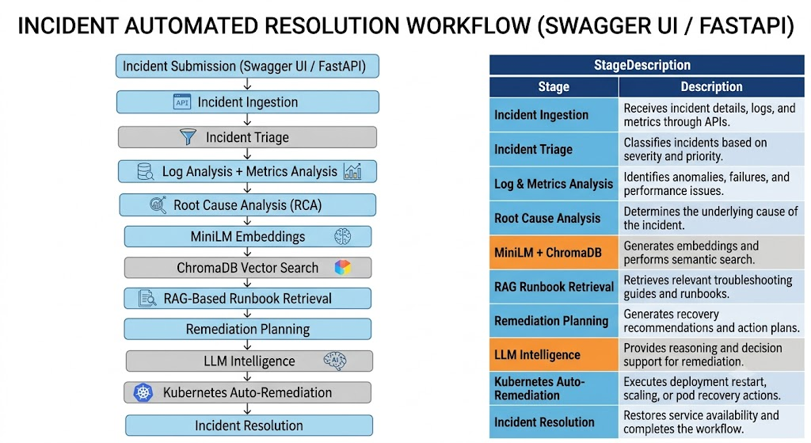
Real-Time DevOps Incident Triage & Auto-Remediation Agent
Pipeline structure

Slide 15
M.Tech/MCA Program
Advanced Industry Integrated Programs
Jointly offered by University and LTIMindTree
Review II
Agentic AI-Based Project Health and Risk Monitoring System for Automated Project Governance
Noel Jacob Biju
MTech AI&ML with LTiMindtree collaboration
T9988
VIT Chennai
Knowledge partner | Implementation partner

Slide 16
Agentic AI-Based Project Health and Risk Monitoring System for Automated Project Governance
Introduction….
Organizations use tools such as Microsoft Planner, Microsoft Teams, and Microsoft Excel to manage projects, but project monitoring, risk identification, and reporting are often manual and time-consuming. To address these challenges, this project proposes an Agentic AI-Based Project Health and Risk Monitoring System for Automated Project Governance using Microsoft Copilot Studio, Power Automate, Microsoft Planner or Excel, Teams, and Outlook. The system automatically monitors project activities, assesses project health, identifies risks and delays, generates recommendations, and communicates insights to stakeholders, enabling proactive decision-making, improved project visibility, and reduced manual effort.

Slide 17
Agentic AI-Based Project Health and Risk Monitoring System for Automated Project Governance
Objective….
The objective of this project is to develop an Agentic AI-Based Project Health and Risk Monitoring System for Automated Project Governance using Microsoft Copilot Studio, Power Automate, Microsoft Planner or an Excel-based Project Tracker, Microsoft Teams, and Outlook. The system is designed to automatically monitor project activities, track task progress, identify delayed, overdue, and high-priority tasks, and assess project health using Green, Amber, and Red status indicators. It leverages Agentic AI to perform intelligent risk analysis, generate actionable recommendations, and provide meaningful project insights to stakeholders. Additionally, the system automates reporting, notifications, and stakeholder communication through Teams and Outlook, enabling proactive decision-making, improving project visibility, enhancing risk management, reducing manual effort, and strengthening overall project governance throughout the project lifecycle.

Slide 18
Agentic AI-Based Project Health and Risk Monitoring System for Automated Project Governance
Module name
Module Name | Description
Project Data Management Module | Manages and organizes project information, including task details, owners, priorities, status, and due dates maintained in Microsoft Planner or an Excel-based Project Tracker.
Task Monitoring and Tracking Module | Continuously monitors project activities and tracks task progress to identify delayed, overdue, or high-priority tasks that may affect project delivery.
Project Health Assessment Module | Evaluates overall project performance and classifies project health as Green, Amber, or Red based on predefined assessment criteria.
Risk Detection and Analysis Module | Identifies potential project risks by analyzing task delays, unresolved issues, dependencies, and critical activities that may impact project outcomes.
Agentic AI Recommendation Engine Module | Utilizes Microsoft Copilot Studio to perform intelligent analysis and generate actionable recommendations for risk mitigation and project improvement.
Automated Reporting Module | Automatically generates project health summaries, risk reports, and governance insights to reduce manual reporting effort.
Teams and Outlook Notification Module | Delivers project alerts, risk updates, recommendations, and status reports to stakeholders through Microsoft Teams and Outlook.
Escalation Management Module | Automatically escalates critical issues and high-risk project scenarios to project managers and stakeholders for timely intervention and decision-making.

Slide 19
Agentic AI-Based Project Health and Risk Monitoring System for Automated Project Governance
Methodology/Modeling Plan….
The proposed Agentic AI-Based Project Health and Risk Monitoring System follows an AI-driven and workflow-oriented methodology to automate project monitoring, risk assessment, and stakeholder communication. Project information is maintained in Microsoft Planner or an Excel-based Project Tracker, which serves as the primary data source. Power Automate retrieves and processes project data, including task status, priority, and due dates, to monitor project progress and identify delayed or overdue activities. Based on predefined rules, the system evaluates project health and classifies it into Green, Amber, or Red categories.

Slide 20
Agentic AI-Based Project Health and Risk Monitoring System for Automated Project Governance
Methodology/Modeling Plan….(Continuation)
The processed project information is then passed to a Copilot Studio Agent, which performs intelligent risk analysis, identifies potential project issues, evaluates their impact, and generates actionable recommendations. The generated insights are automatically compiled into project reports and communicated to stakeholders through Microsoft Teams and Outlook. Additionally, critical project risks trigger escalation workflows to ensure timely management intervention. This methodology combines data monitoring, project health assessment, Agentic AI-based analysis, automated reporting, and stakeholder communication to enable proactive project governance and informed decision-making.

Slide 21
Agentic AI-Based Project Health and Risk Monitoring System for Automated Project Governance
Data preprocessing & EDA….
The Data Preprocessing and Exploratory Data Analysis (EDA) phase ensures that project data collected from Microsoft Planner or an Excel-based Project Tracker is accurate, consistent, and suitable for project health assessment and risk analysis. During preprocessing, the project data is reviewed to identify missing values, duplicate records, inconsistent task statuses, and invalid due dates. The data is then cleaned and standardized by ensuring uniform task status values, valid date formats, and complete task information such as project name, task owner, priority, status, and due date.

Slide 22
Agentic AI-Based Project Health and Risk Monitoring System for Automated Project Governance
Data preprocessing & EDA….(Continuation)
Following data preprocessing, Exploratory Data Analysis (EDA) is performed to understand the overall project condition and identify patterns within the dataset. This includes analyzing the total number of tasks, completed tasks, pending tasks, overdue tasks, task distribution by priority, and project-wise task progress. EDA helps in identifying potential bottlenecks, frequently delayed activities, and high-risk project areas. The insights obtained from this analysis serve as the foundation for project health assessment, risk detection, and AI-driven recommendation generation within the proposed system.

Slide 23
Agentic AI-Based Project Health and Risk Monitoring System for Automated Project Governance
Approach/Algorithms/Tools….
The proposed Agentic AI-Based Project Health and Risk Monitoring System adopts a combination of rule-based analysis, Agentic AI, and workflow automation to automate project governance activities. Project data is collected from Microsoft Planner or an Excel-based Project Tracker and processed using Power Automate to monitor task status, priorities, and due dates. The system applies task delay detection and rule-based project health assessment techniques to classify projects as Green, Amber, or Red based on predefined criteria. A Microsoft Copilot Studio Agent then performs intelligent risk analysis, impact assessment, and recommendation generation to support decision-making.

Slide 24
Agentic AI-Based Project Health and Risk Monitoring System for Automated Project Governance
Approach/Algorithms/Tools….(Continuation)
The proposed Agentic AI-Based Project Health and Risk Monitoring System adopts a combination of rule-based analysis, Agentic AI, and workflow automation to automate project governance activities. Project data is collected from Microsoft Planner or an Excel-based Project Tracker and processed using Power Automate to monitor task status, priorities, and due dates. The system applies task delay detection and rule-based project health assessment techniques to classify projects as Green, Amber, or Red based on predefined criteria. A Microsoft Copilot Studio Agent then performs intelligent risk analysis, impact assessment, and recommendation generation to support decision-making.

Slide 25
Agentic AI-Based Project Health and Risk Monitoring System for Automated Project Governance
Project plan/milestones progress
Milestone | Status
Project Planning & Requirement Analysis | ✅ Completed
Project Data Source Preparation (Planner/Excel) | ✅ Completed
Copilot Studio Agent Development | ✅ Completed
Power Automate Workflow Development | ✅ Completed
Project Health Assessment Implementation | ✅ Completed
Risk Detection & AI Recommendation Generation | 🔄 In Progress
Reporting & Notification Integration | 🔄 In Progress
Escalation Management Implementation | 🔄 In Progress
Testing & Validation | 🔄 In Progress
Documentation & Final Presentation | 🔄 In Progress

Slide 26
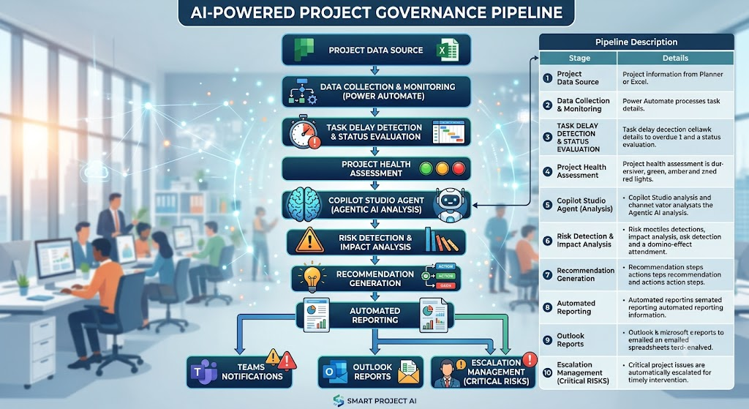
Agentic AI-Based Project Health and Risk Monitoring System for Automated Project Governance
Pipeline structure

